Slide 1
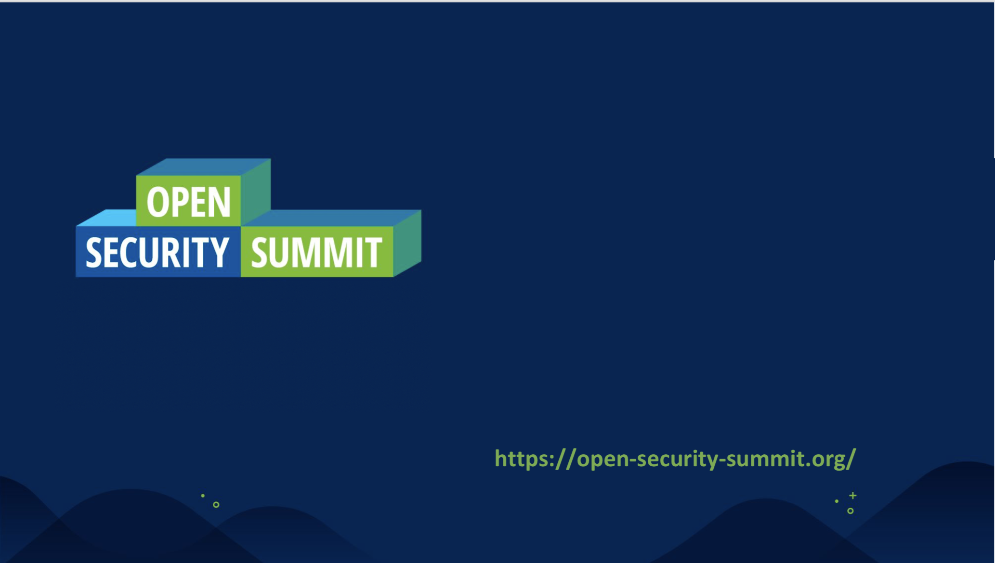
Sensemaking and Strategy with Cynefin framework

Slide 2
Agenda
3 types of Systems
Complex Adaptive Systems
Affordance
Intro to Cynefin
The Tyranny of Expertise
Heuristics for managing in Complexity
Cynefin Domain Models: Chaotic, Complex, Complicated and Clear
Using Cynefin methods to develop Strategy
Scaffolding
Constraints
Being Aware and 6 Exit Strategies
Analogies - Apex Predator, Hyena, Parasite
Closing Thoughts

Slide 3


3 types of Systems

Slide 4
3 Types of Systems in Nature
Ordered systems
Behaviour is predictable because agents are constrained
Repeating relationships between cause and effect
Predictable future behaviour and manipulate it toward desired state
Chaotic systems
Agents are unconstrained
Gain insight by use of statistic, probability distribution etc
Complex Adaptive Systems
Constraints are loose and partial
Dispositional, not causal
Nature of constraints is constantly modified by interaction of agents
They co-evolve
Notes:
Complex adaptive systems theory is the basis of the Cynefin framework
Ordered - high level of constraints (something which contains or connects), it’s predictable, we know what’s going to happen, clear relationship between cause and effect
And because it’s ordered, it’s very attractive for us humans and we often take it to excess but the cost of achieving this order is massive. Think of all the things we put on checklists in security, and how well that is going for us. Do people actually pay attention ? the heuristic here is that when we overconstrain a system that is not naturally constrainable, we get breakdown. Think of expense systems, or even if we don’t want to admit it, our compliance checklists. People will create covert work systems or just ignoring as they can, gaming the system.
Chaotic - no effective constraints. Not contained, nothing seems to be connected, it’s a mess. Key management action is to introduce constraints, this is where crisis management comes in. you don’t look to find solutions in this type of system, you mainly want to create some type of structure so you introduce constraints but knowing that introduction of these constraints will create a new type of system as it will change with the actions taken. But if you go there on purpose, you may find yourself doing radical innovation.
Complex adaptive systems - there are constraints, generally not containers. all is connected with everything else but nature of the connections may be very different , situation is unforecastable and no linear relationship between cause and effect. System is dispositional (will have a tendency to act or behave in a certain way) not causal, so when I do interventions I can’t be certain of its outcomes or clearly associate an effect with a particular cause.
I can’t predict, but if I have real time access to data from it and I can control things which cause effects on it (we call them modulators in Complexity) then I can through feedback loops control what happens to it and how it behaves
Cyber Security is a Complex adaptive system. Our organisations are Complex adaptive systems. And we tend to forget that security, as safety, is an EMERGENT property of a system and not a thing we do or implement or buy technology for so when making changes to our organisations we’re co-evolving its security property as is every other change in our organisations

Slide 5
What is Complex Adaptive System ?
“A complex adaptive system is a system in which a perfect understanding of the individual parts does not automatically convey a perfect understanding of the whole system's behavior. In complex adaptive systems, the whole is more complex than its parts, and more complicated and meaningful than the aggregate of its parts”
from Wikipedia

Slide 6
“Affordance is what the environment offers the individual” James J. Gibson
Notes:
Another key concept is that of Affordance.
Beware of the professionals, whether Security or not, that go into an organisation knowing all the answers and what the strategy needs to look like before fully appreciating the affordances provided by the environment they’re in. If we go into any organisation knowing all the answers upfront “because we did it elsewhere” then we blind ourselves to attain the situational awareness that will help us make sense IF the particular environment we find ourselves in can afford the changes we’re about to embark on, and that point we’re not being any better than the canned consulting approaches with one-size-fits all, which is NEVER the answer for something which is an emergent property of a system as we discussed.
In a nutshell, affordance is what the environment offers the individual so there are lots of strategies and interventions that may NOT be available to you as your environment may not provide you with that affordance and when that is the case we need to re-think proximate objectives or what needs to be addressed first before a particular strategy is available to us or choose something else entirely which our environments can afford

Slide 7
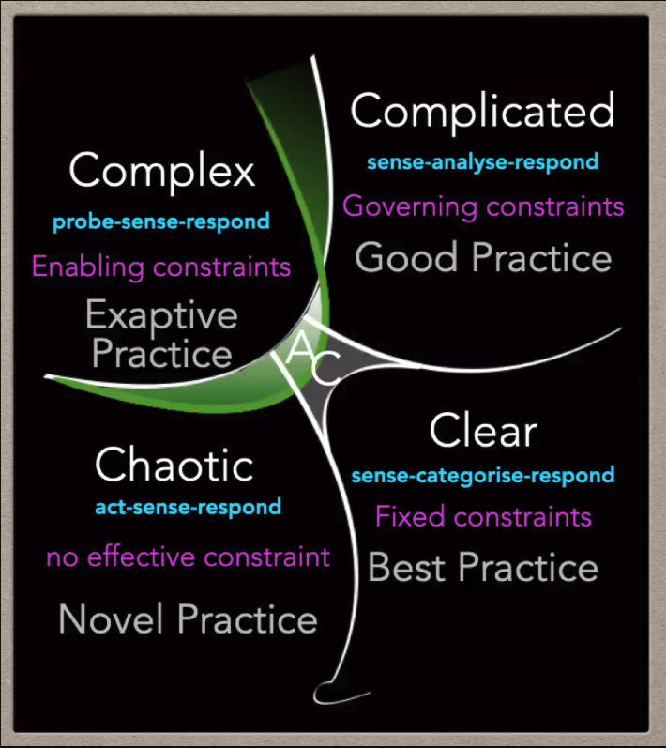
Notes:
So finally we’re at the Cynefin framework, which is a way to look at reality.
It has 5 domains which map to the 3 types of systems we discussed (Complex, Chaotic and Ordered) but divides Ordered systems into 2 (Complicated and Clear), but this distinction as we’ll see isn’t as significant as it relates only to the expertise of the decision maker, as Cynefin is a framework to be seen from the perspective of the decision maker.
Let’s start with the domain in the middle which is A/C or “Aware / Confused’. It used to be called Disorder, but has been updated a few months ago, and now clearly separates being “Aware” which implies legitimate confusion which allows for transition, from “Confused” which relates to the act of being ontologically ignorant, meaning not knowing the nature of the situation or system we’re dealing with. We’ll come back later to what we can do when we’re in Aware.
In both Clear and Complicated, there is a linear relationship between cause and effect. The main difference is that in the Clear domain everyone can see that relationship and no one disputes it. We clean our hands, because we know we can get sick if we don’t.
In Clear, what we do is “sense categorise respond”. We sense the type of system we’re in, we put it in a box and respond accordingly. In Cyber Security, long passwords fall under this category, playbooks and runbooks, signature-based anti-malware this type of stuff. But when we overconstrain it we get collapse into chaos. For instance, a signature which is too generic, or all the bad security advice on passwords management of the last 20 years with force changes every 10 min which actually lead to poorer choices of passwords and leaves us more insecure (which to me is the classic example of catastrophic failure of what was supposed to be a Clear system). So this is the domain of best practices. The classic example by Dave Snowden on how even in a Clear system should allow for exceptions if they’re properly constructed, is driving in your lane in any country. One would not expect to go to jail if we swerved our cars to the wrong lane in order to avoid hitting a child in front of us, though everyone knows which lane they should be driving in depending on the country. that would be zombie-like enforcement of rules. Here we have Fixed constraints, where we can define things such as checklists or best practices.
In the Complicated domain, it’s not self-evident except for Experts, so this is the domain of expertise. Where we practice our expertise, CyberSecurity generally falls here as the decision makers turn to us when they don’t know what the right thing to do in this domain is. So the decision makers do know there is a solution or approach, they don’t know it themselves but know that we do. So the decision model here is “sense - analyse - respond”, so here we apply good practices which will vary depending on the actual on context so where we Cyber security professionals analyse data, ask questions and then provide a direction. And here-in lies a big problem: we as experts can be relied on when the problem lies within the bounds of our expertise, but if the problem is Complex we should create hypothesis, and hypothesis can be wrong (that’s what happens with hypothesis, so it’s expected) but, as Dave puts it “if we treat a Complex system as Complicated and the expert gets it wrong, we lose trust in expertise” and this is how we lose trust with our key stakeholders. In the Complicated domain, we have Governing constraints so we create boundaries, but within those boundaries there’s some level of flexibility as opposed to in the Clear domain where constraints are Fixed or Rigid.
The best example I like to give on this, is how most Infosec teams write policies which actually dictate approaches as opposed to only setting control objectives and leaving our technical teams to have some boundaries to work with, and if that’s you then I hope this bit convinces you to significantly reducing the verboseness of your security policies at the risk of overconstraining your system and potentially come to fail catastrophically. The part at the bottom of Clear, is meant to portray a Cliff in that when Clear systems fail, you tend to find yourself in a Chaotic situation.
In a Complex situation, we don’t know what the right solution is until we act as we don’t have a linear relationship between cause and effect, so here the decision model is probe - sense respond. The heuristic for Complex domain is that we have multiple coherent and conflicting hypothesis that can’t be resolved in the time available to make a decision or an acceptable timescale and we run parallel safe to fail experiments and its those experiments which reveal what’s possible. Remember that interventions in a Complex Adaptive system changes the system itself. In Cyber Security, this can mean doing different types of experiments with CI/CD tests, different types of training with different teams, applying different types of constraints to business processes in different locations with limited budget allocations to each and see which ones work best and allow for emergence of practices. Here practices are emergent or exaptive, which means radical repurposing where something can potenntially be used to serve the same purpose (think opening a beer bottle with a lighter when you don’t have an opener). In Cyber Security, when we change through policy or other means the ways of working of others we can expect practices to change not necessarily in accordance to our intended change (leading to work as imagined) but how the practices emerge to potential create covert work systems which is the work-as-done, and everyone who made process changes in organisations and actually assessed it a year later will know they have detected discrepancies that we then create or introduce even more constraints or interventions to “fix broken” processes which never worked as we intended to or how we imagined in our process flows they would. Constraints in Complex domain, are Enabling constraints so more like rules of thumb, as opposed to the Governing constraints (rules) of the Complicated domain. So we should aim to find ways to identify the natural constraints which exist in their day to day narratives, and attach teaching stories to them
I’ve been playing with this idea of rules of thumb in terms of promoting the use of security baselines. In the US Marines they have “Capture high ground, Stay in touch, Keep moving”. I think in Cyber Security we could do with something like: “Secure your dependencies, Protect your secrets, Scan your code, Harden your config” but am yet to have results to comment on.
As a final note, we should not define goals in a Complex adaptive system, as gap thinking doesn’t work because of no linear relationship between cause and effect, and we should instead think in terms of vector measurements. Ie “is the system evolving in the direction I want ?”
In the Chaotic domain, there’s no pattern, no constraints. If I want to deliberately move things into the Chaotic domain, I just get rid of the constraints typically in a sandpit so it doesn’t affect the whole. So we Act - sense - respond and this is also where we can find novel practices.

Slide 8
Tyranny of Expertise in Cyber Security (Complicated)
“A reality in Cognitive Science is that we assess a situation based on how we’ve already decided to act” Dave Snowden
Notes:
in Cognitive Sciences, it is often said that we assess a situation based on how we’ve already decided to act, and this is what I call the tyranny of expertise in Cyber Security, as we tend to treat all problems as if they’re Complicated or with methods compatible with the Complicated domain when they’re not and this leads to a lot of failed change initiatives and a lot of frustration too, both by us, our teams and our business constituents. Hopefully learning about Cynefin can help us as an industry get better at understanding the different problem spaces and choose appropriate methods

Slide 9
Heuristics of managing in Complexity
Questions:
What can I change ?
Out of those, where can I monitor any impact ?
Out of those, where can I amplify success or dampen failure ?
Principles:
Optimise the granularity (generally smaller)
Distribute Cognition over diverse sensor networks
Disintermediate decision maker
Things to avoid:
Retrospective coherence, hindsight does not lead to foresight
Premature convergence on a decision/assessment
Pattern entrainment of past success or failure
Notes:
Without feedback on our actions we are acting like its complicated not complex.

Slide 10
Cynefin Domain Models
Notes:
The Cyefin domain models are are a way to understand and learn to navigate each of the different domains (apart from A/C which we have exit strategies ffor and will cover at the end), ad we’ll look now the the 4 domains.
And the main thing to bear in mind when look at the domain models is that it’s as much static assessmennt (so where am I now) as it is about change (so how do I move situations between domains and WITHIN domains)

Slide 11
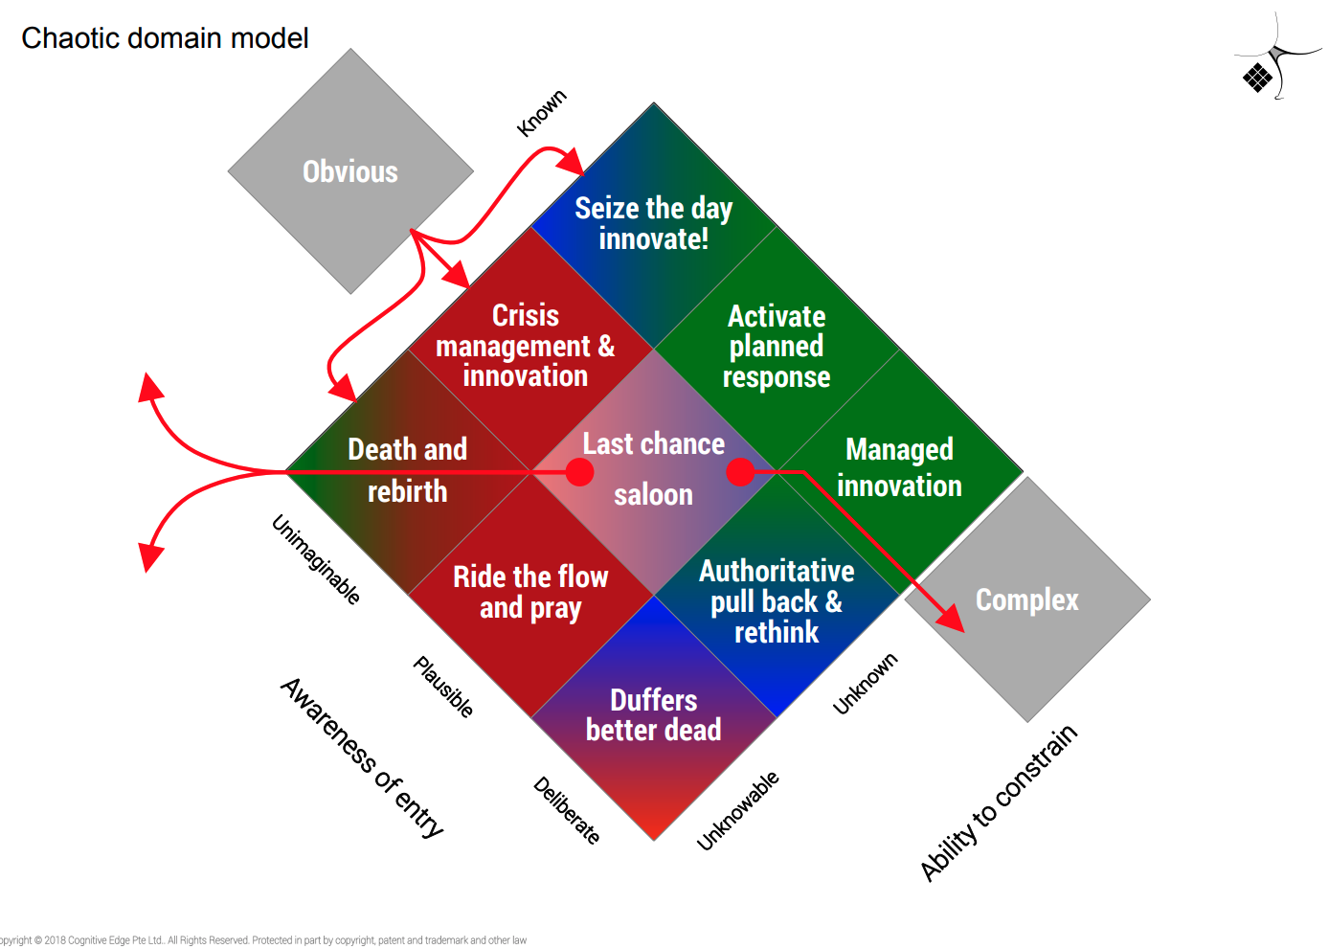
https://cognitive-edge.com/blog/complex-domain-model-april2013-edition/ @snowded
Notes:
In the Chaotic domain when entered accidently it’s a problem and you need to get out as quickly as possible but when done deliberately it can be a great source of innovation.
Here we have on one axis “Awareness of entry”, which ranges from being deliberate so I chose to go there, Plausible in that it’s a scenario I could foresee though I may not have planned for it and finally uninmaginable in I didn’t expect I’d be facing this situation
On the other side we have our ability to constrain the situation, because the way out of Chaos is through constraints. Known in that I know what it needs to happen here, Unknown as in I can work out how I can or should constrain this or Unknowable as in it’s completely out of my imagined scenarios and I need to hold on tight and hope I survive it.
The boundary with Complex is Managed innovation, so we went there on purpose by removing or relaxing constraints and I know how to reintroduce them if things get out of hand. Next we have “Activate planned response” and this is where our Crisis or Breach Management plans come into play, and at the top I didn’t think it could happen but I can understand what needs to be done, it’s the “Seize the day innovate” box. This is a HUGE opportunity for us in Cyber, as we can sometimes use this opportunity to introduce measures or initiatives that otherwise we wouldn't have the political capital to make happen. Organisationally speaking, Dave Snowden recommends having an Innovation team which triggers in parallel with the Crisis Management team so we can be more deliberate about making the most of Crisis situations and make effective and positive changes.
Further down are the dangerous bits. Authoritative pull back & rethink happens when we relaxed constraints even further and are having difficulting understanding how to manage it, it’s a bit dangerous but still ok. The last part “Duffers better dead” is about throwing away all constraints without being prepared to manage it, and that’s silly. It’s a reference to one of Britain’s most famous telegrams (duffers means someone incompetent or mediocre), where a mother sends a telegram to the father who was in the Navy (1920s) so he can approve or disapprove their children to go spend a weekend alone on a lake, and the father responds “If not duffers, won’t drown. If duffers better drowned”
So you shouldn’t go there
Last chance salloon, is where a lot of us find ourselves when our planned responses aren’t giving us the results we expected. We need to get control very fast or we’ll be in a lot of trouble soon. If things deteriorate further into the unimaginable w’re into Crisis management and innovation, where only a select group of 2-3 individuals should be making any type of decisions and no delegation is allowed. The decision maker needs to tightly control this.
Ride the flow and pray when its plausible and unknownable, and interfering can potentially even make it worse. So here we sit down, wait to see how the situation unfolds until we’re ready to introduce constraints again.
And finally, the place most wish we didn’t have to go there, is Death and rebirth. It maybe that you just need to let it die quickly, so something can emerge from it or you can take the learnings elsewhere and start over. Holding on to things past they’re usefulness isn’t helpful for anyone, and accepting failure is a skill in and of itself.
The 4 boxes to the right are Liminal, in that if we build narratives about the past can help us define transition states to other domains as we’re sometimes in Crisis and may not even realise it (unintentional blindness)

Slide 12
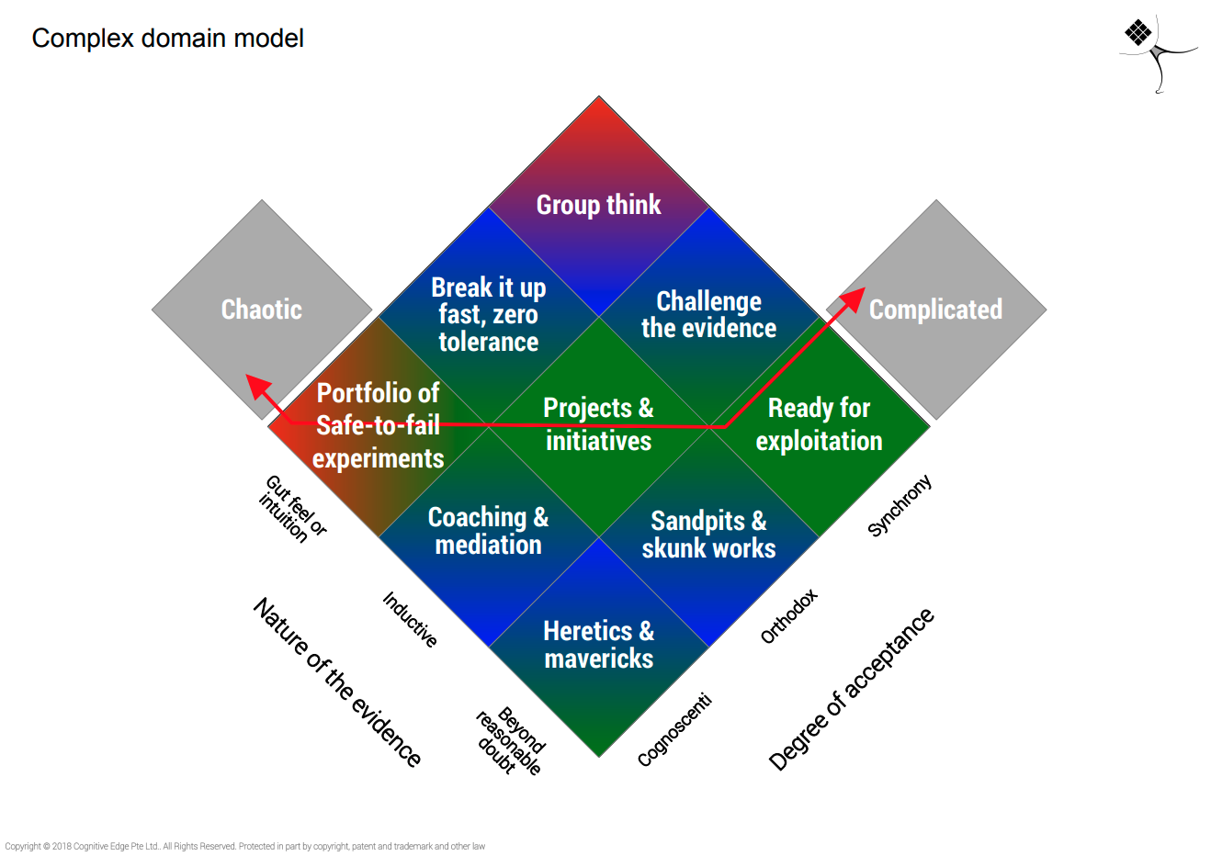
Liminal
https://cognitive-edge.com/blog/complex-domain-model-april2013-edition/ @snowded
Notes:
In the Complex domain, we don’t direct causal relationships so we have to have some degree of evidence so our hypothesis can be coherent or have some coherence and it has to have a degree of acceptance otherwise the context will not provide the decision maker the affordance to make a decision in that direction and to experiment
On nature of the evidence, can be “beyond reasonable doubt” in that it’s been proven and should soon be ready to move to Complicated, “Inductive” means that there are several cases that it works and we can prove it and finally “gut feel” in that no one really knows, it may look and sound coherent but too early to tell for sure.
THe Complex domain has on side degree of acceptance (which can be cognoscenti or a few elite that understand it) and it’s kept as such, it can become orthodox in that most people accept and finally Synchrony (which comes from the Resilience literature) which largely means everyone is walking in step and no descent so, again it may be ready to move onto the complicated domain
So, in the middle we have “Projects and intiatives” which experiments with coherence that you’re keeping there in order to test and improve its stability as we should do in the Complex domain. If I can start getting some stability, we can move it to Ready for Exploitation where we introduce further constraints to stabilise and mvoe into the Complicated domain.
However, a lot fo the good ideas on how to address Complex problems go to the bottom. A few know what to do, but nobody will or wants to believe them, so this is where we find Heretics and Mavericks, and they often lack the language and communication skills to get higher degrees of acceptance so we need mediation techniques to move something from there. So one of the ways to manage this, is through sandpits or skunkworks. In Cyber, this may mean hiding an initative from most of the company, get your heretic to work with a select few on a side project that no one else know about to prove and stabilise it. Transparency is NOT the way to go here, as internal inertia may kill any chance of success and other boycotting it.
Another strategy is “Coaching and mediation”, where we don’t know if it will work or not but the heretic can help interpret it and get a select few working together to further explore the ideas and their implications and also that have broader support networks that can help disseminate and convince others. This is an indirect route, in that convincing particular stakeholders may be difficult, but if you convince people they trust first it greatly increases your chances of future success.
At the top, we have Groupthink which is dangerous, everyone is in step but based on gut feel. In Cyber, a lot in our industry the move to DevOps is having them think this way. The gut feel tells them releasing software that often is certainly going to lead to more vulnerabilities (if when we did it slowly, it was awful and much worse will it be if we accelerate ?) but hopefully this audience will know that’s not actually the case.
And now for some controversy from me. We have 2 ways to deal with that: if we see that happen, we need to break it up fast. That may mean that the best thing for your organisation may be to let go your current Infosec team or a few of its elements, as a leader you sometimes need to make hard decisions. A bit less dramatic, is to stop having those people work together, and integrate them for a season directly in Product teams so they can start having better appreciation for how things actually work.
Another strategy is to Challenge the evidence, if there’s more proof to it. This is where intensive training can come in as well, let’s unpick assumptions both about what the job of security is and the types of conditions which are required to release multiple times a day which are required to ensure operational stability and how security can leverage and capitalise on some of those practices
<my anecdote from DCG. entrained Group Think, highly scared environment of DevOps and bad process, so had to break it up new people in as <heretic> to work on skunk works and start developing some practices to then exploit)

Slide 13
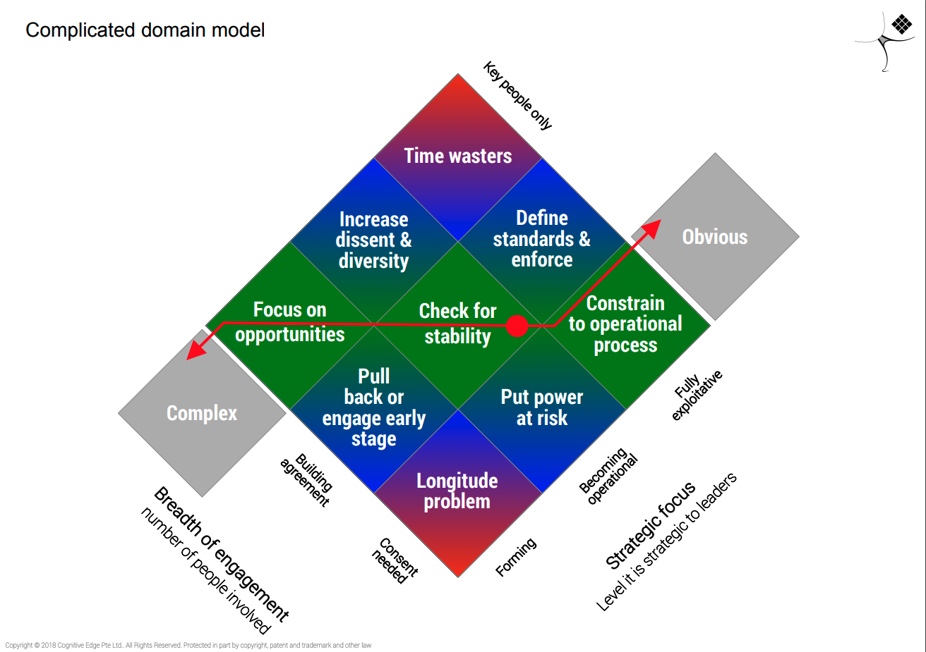
Notes:
THe complicated domain is where we have expertise and analysis.
So the 2 dimensions here are breadth of engagement, so the number of people we involve and also the strategic focus. Not necessarily strategic for the company, but strategic for us as security leaders.The rule of thumb, particularly for leaders is that when you can move out of the Complex domain and constrain the problem so it’s Complicated you ideally want to delegate this to your Junior managers or team members, generally speaking. So breadth of engagement ranges from just a few key people being involved. Breadth of engagement ranges from consent needed when everybody needs to buy in, and is required before you move it into the Clear domain, building agreement and having only a few number of people involved. In Strategic focus, it ranges from forming, becoming operational and fully exploitative and ready to be turned into the Clear domain. I’ll use Threat modelling as example throughout this domain.
Threat modelling was once complex without any true methods behind. But Adam Shostack had iterations, wrote a book and stabilised the practice so other frameworks could emerge and security professionals could start using it as a method.
In Cyber, we can think of this as when first introducing Threat modelling we may want to start with some key people only, building expertise within the security team for instance.
Focus on opportunities would be about introducing in a few projects where we have the affordance to try something new and not as part of any type of governance, we just go ahead and do it. Particularly in companies with a culture of being reticent about security introducing practices, over publicising it too soon gives some the opportunity to potentially sabotage it. When that progresses, we Check for stability and we shouldn’t rush this to ensure that we check what works and doesn’t in our own organisation and its dynamics. After we consider it stable and producing intended results, we can then constrain them move to an operational process.
Then we have the edges. At the bottom, it’s the longitude problem. In short, that refers to what happened when a British furniture maker found a novel way to manage Longitude and he had both a theory and scientific validation, but no one believe him because that wasn’t the type of solution that the scientific community was expecting so it took years to get acceptance. The cautionary tale here, is that even if you’re right and an prove that a particular course of action is preferable it doesn’t mean you’ll get acceptance in the organisation to introduce threat modelling for all projects. To address this we have a low risk and high risk strategy. Pull back or engage early, is to drop the idea, wait for a period try and describe it differently later to try and re-introduce it. The high risk ‘put power at risk” strategy would be, for instance if the CTO isn’t giving you permission to work with the different technical teams to introduce threat modelling, you go to the CEO to force it, if you really want to make it happen.
At the top, we have Time Wasters. It’s only in the hands of a few key people, it’s ready to be exploited but they won’t let go. Instead of using simpler methodologies for Threat modelling, they decided to keep the practice full of jargon and complicated models and are forcing the practice to only happen in their presence and their approval.
When this happens, you try and break the team holding onto it and increase diversity so they can’t hold on to it as a unit, or just take it off their hands, have them define standards for the practice and ensure they no longer hold on to it.
The theme in the Complicated domain, is that a lot of it has to do with Power, typically supported by specialist knowledge either in the form of political capital in the organisation which needs to be managed and considered, or even within your own teams with regards what they perceive their roles to be and what feels comfortable to them.
<tell my anecdote at Three UK with the Firewall changes done by UK resources instead of my team in India>

Slide 14
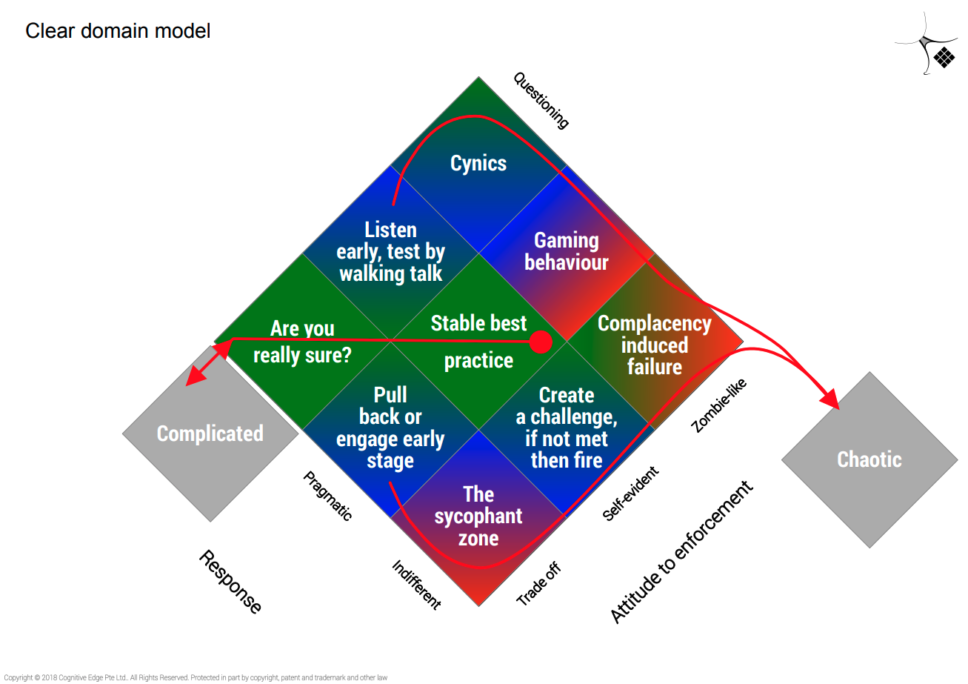
Notes:
The last domain model we’ll look into is for the Clear domain. This is only for things that will be highly stable for long periods of time that you believe you’ll need to exploit, and that’s why what we say here is “are you really sure?”
So the 2 dimensions here are attitude to enforcement because deviation is not something you can afford and response to it, so how do people feel about it.
On Attitude to enforcement it starts with Trade off. Here, there are things that matter to you but not that much that you’re going to have to do something about it and you just compromise. Self-evident is…. Self-evident as it says on the tin, and finally zombie-like is that rules are enforced regardless of consequences which can get us into Chaos.
In Response, we have “Questioning” so are we really sure, pragmatic in that people just accept it or indifferent in that people will just do what they’re told to do
Here, what good looks like is that you confirm you want to do it, and then keep it at stable practice, and that’s it. We want it to be Self-evident AND pragmatic. If you see indifferent or zombie-like, you have problems you need to deal with.
If it moves down to Trade off, it’s like people don’t really agree but also don’t have the energy to fight it. And if it moves even further down, there’s not even any questioning they just do whatever you as the leader tell them to, and that should tell you you’re really failing your team if that’s the case. If you’re not the problem, you should create a challenge and work out what’s happening and if it doesn’t work, you’re looking complacency induced failure and may fall into Chaos
The other side tends to be more common. You think it’s self-evident, but there’s a group who is still questioning. The best way to do manage this, is to listen and walk the talk (test the ideas for yourself, and go through the processes to try and understand what the concerns are and address them). The Cynics are those that keep questioning but follow the rules zombie-like, but remember that Cynics are those who care and especially with people who’ve been in service long, you should listen and maybe you’ve moved it too soon into the Clear domain. I remember at a big corporate, getting to the point of just telling everyone in the team and my manager “Your process is making me lose close to 1 day a month doing expenses. If that’s what you think a good use of my time is, that’s on you. I’m not arguing anymore”. But I’d make it a case of telling him the morning of every month, today I’m not doing anything, come back tomorrow. Gaming behaviour is when people understand the scope of the rules and work around them or at its limits, for instance I’ve worked with a customer that they had to click a specific field in JIRA for it to go to CAB for security to review, but because they were perceived as useless, only about 5% of what should go there would, people would just pretend and apologise later if needed.
<anecdote at big corporate/VF with Firewall change process…… Had both Cynics and Sycophants everywhere, the process was appalling and super expensive, and even some evidence of gaming behaviour of people adding to project work, firewall requests that had nothing to do with said project because it was much quicker and easier when compared to Business as usual type changes and a Capex code already existed). Had to pull back and engage early, deal with some of the concerns and find clear strategies to deal with a few of the issues to establish a new stable practice which was both pragmatic and self-evident, and saved the company over £1M a year in change costs

Slide 15
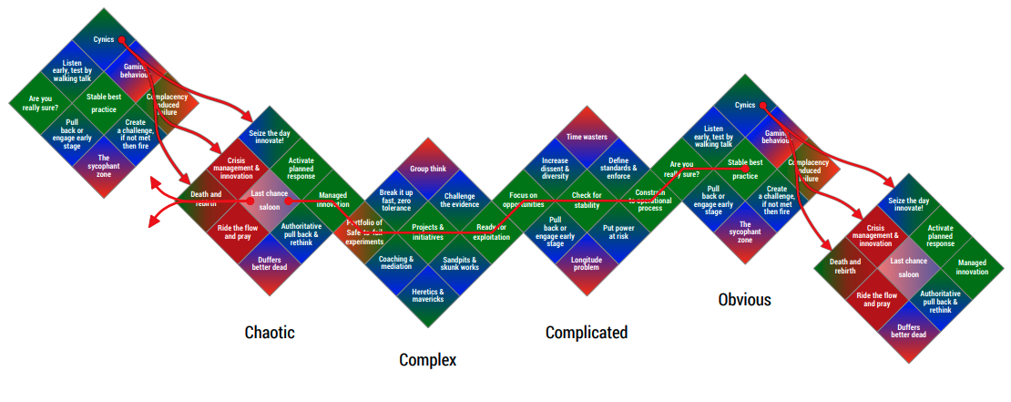
Cybersecurity in the Domain Models
Crisis Management
Experiment & Listen
Be an Expert
Empower others - Agency

Slide 16
Using Cynefin to inform/develop Cyber Strategy
Notes:
So how can we go about the business of developing strategy with other concepts from Cynefin framework ?

Slide 17
Scaffolding
“Construct which supports the emergence of something which can sustain its identity” Dave Snowden
Integrated approach to Quality & Operational Stability
Culture of managing risks to attaining objectives
Notes:
This idea of scaffolding is paramount for effective Cyber Security. Now this is critical if you are going to take the position that applications and capability should be the emergent property of the interaction of people and their artefacts within constraints. The scaffolding provides the constraints which need to be strong enough at the start of the process but should evolve to be a part of the evolving identity of the organisation.
Now there are 2 ways to think about this. One of them is to think about the Cyber Security scaffolding, we can either think of it as something which should stand on its own or we can think about what other aspects that may already be in the DNA of the organisation which we in CYber Security can leverage as scaffolding.
There are organisations that may not necessarily show significant care for Cyber Security, but which have either a very mature approach to a definition of quality and operational stability and/or where the management team are conscious of market risks, or project management risks and very apt at managing them. When these exist, Cyber Security should be framed as an add-on as that type of scaffolding is the identity of the company so it will require less energy to DO the security things without having to frame as something which stands on its own.
And if even if we don’t have those, anything that we CAN do to frame it as such and support our other stakeholders in building that scaffolding will pay dividends in the long run in terms of company culture, so this is a lens which I prefer to use when thinking and building security governance and processes. Let’s not just think about ourselves and our immediate needs, but framing as addressing other stakeholders problems will make them see as the allies we should be, and those relationships will pay off in the medium to long term.

Slide 18
Robust vs Resilient
Robust: A system is robust when it can continue functioning in the presence of internal and external challenges without fundamental changes to the original system.
Resilient: A system is resilient when it can adapt to internal and external challenges by changing its method of operations while continuing to function. While elements of the original system are present there is a fundamental shift in core activities that reflects adapting to the new environment.
Notes:
Robus is all well annd good until design conditions are exceeded, then they fail catastrophcally
Resilience is about adaptive capacity

Slide 19
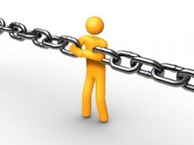
Constraints
Primary distinctions
Contain or connect ?
Exoskeleton or endoskeleton ?
Resilient or robust ?
Robust constraints
Rigid
Elastic
Tethers
Resilient constraints
Permeable
Conditional
Dark
https://cognitive-edge.com/blog/a-return-to-constraints/ @snowded
Notes:
So, before going further just a quick recap on constraints for each of the system types. This a typology again, don’t force things to fit it, it’s just to help us think and get divergence in our own thinking and communication with others.
In ordered system, system itself constrains the agents
In a chaotic system, the system is entirely unconstrained so our management job is to introduce constraints
In a complex system, the system lightly constrains agents but when we interact with the system we modify it
So this nature of constraints suggest how we should manage in each, and I’ll try to use Cyber Security examples as much as possible.
The primary distinctions are: does the constraint contain or connect ? Constraints which contain are like an exoskeleton which defines boundaries around something so they’re likely to be Governing constraints (so more suited to the Complicated domain), A constraint that contains can be MDM software, for instance, where we get often a completely separate container from the main device to protect corporate data on a mobile phone.
A constraint that connects defines interactions between entities that form part of a system. A constraint that connects is probably an Enabling constraint, so more suited to the Complex domain
A constraint that connects in security, can be leverage an already working Data Protection Impact assessment process to extend to include a security assessment too in order to avoid business stakeholders to have to go through an additional governance process for instance. C
And the, are the constraints robust or resilient ? we’ve covered the difference but let’s look at the detail. Resilience, as per David Snowden, is “survival with continuity of identity over time”
Robust constraits:
Rigid - means they’re defined, visible and can be enforced. THey are certainty but are also subject to catastrophic failure when limits are reached. A Cyber Security example is Security Policies that stick to defining control objective and go into a lot of technical detail defining a rigid expectation likely divorced from your operational reality and creating a business liability when the auditor comes in to check and realises it’s just a load of BS, or pretty words on paper without much substance
Elastic constraints can adapt to a degree of change but can still break and give a false level of confidence. An example in Cyber would be properly written security policies defining high level control objectives and leaving agency to our technical teams to implement them as they see fit, but may break due to unawareness or misinterpreting them
Tethers provide a backstop, think of a tow rope which has slack taken up before it applies. They;re fail-safes, backups which only come into play in extreme situations. They can damage when snapped into effect, both to itself and the object protecting. I’d class untested recovery processes to fall into this category. They’re there to provide some comfort, but when we actually need them experience tells me it’s not often they work and don’t create other problems.
Resilient constraints:
Permeable - these are contingent, some things get through, others don’t. In Cyber, an example could be where we allow rules to be broken under heuristic control. For instance, you’re allowed to deploy a system with a critical vulnerability identified as long as there isn’t known exploit for it and you plan to fix it within a week, provided exploitability doesn’t change
Conditional or mutating - in that they change over time and you can see an evolutionary pattern. Case based law is a good example, in that rulings help inform the boundaries of being lawful and change over time with societal changes
Dark - these are like dark matter, we can see their impact but don’t know what they are. Organisational culture falls here, as does security culture and taking a Complexity approach to it, there won’t be direct causal relationship on how your security culture may be good or bad but understanding it has an impact on potentially what are modulators you can use and feedback loops you can assess to assess changes over time is important. Hint: it won’t be with your typical change programmes of adding tools, practices or awareness that you’ll necessarily improve it, and they may actually be detrimental

Slide 20
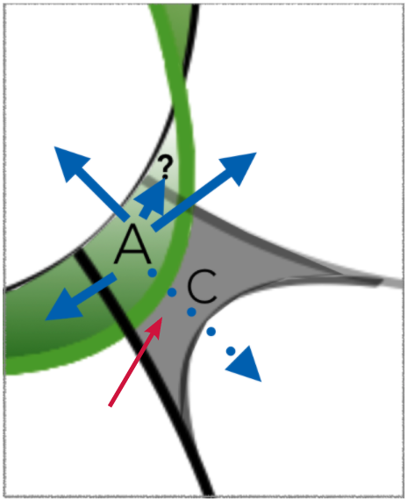
Being Aware and 6 Exit Strategies
Conflict the experts
Parallel safe to fail experiments
Prior ignored experts
Draconian constraints
Nullify process freaks
Intractable MassSense

Slide 21

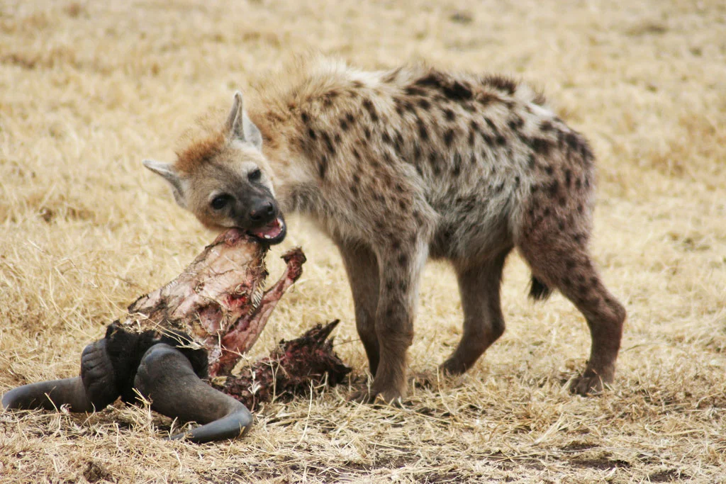

Strategy Analogies from Nature
Apex Predator - Yosemite Wolves
Hyena
Parasite
Notes:
Parasites live off of the host directly
Hyenas live off of what the Apex predator doesn’t get
Apex predator do what they want, as they can’f fail until the conditions in the environment change. Microsoft/Apple, not necessarily Agile, they’re apex predators so can’t fail by definition until the environment conditions completely change

Slide 22
Strategy Analogies from Nature
Apex Predator - Gray Wolf (Yosemite National Park)
Hyena
Parasite
Energy Gradient
Setting our own plans, compete for resources
Recovering from incidents & situations
Integrating into other’s transformations

Slide 23
Cynefin helps us make sense of the problems we deal with so we treat them according to their nature
Notes:
So how can we go about the business of developing strategy ?

Slide 24
